Slide 1









HONEYWELL
AI-DRIVEN EMBEDDED
PRODUCT LIFECYCLE
ORCHESTRATOR
VERSION 10
Embedded Lifecycle Intelligence PRD -> PG3 Firmware -> JTAG Evidence -> QA Ready -> STQC
Atharva | Manas |Sheraaz |Shyam
1 / 9
Notes:
"Today we are showing AEPLO, the AI-driven embedded product lifecycle
orchestrator. The 3-minute story is PRD to firmware, firmware to JTAG
evidence, evidence to QA release readiness, and finally STQC submission
readiness for regulated IoT security and surveillance products."

Slide 2
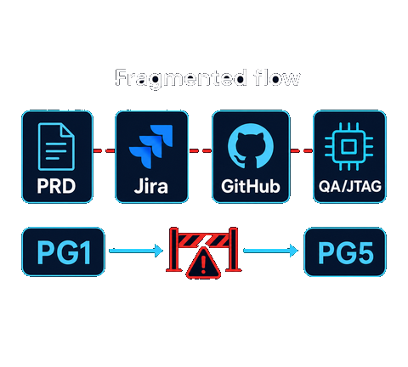
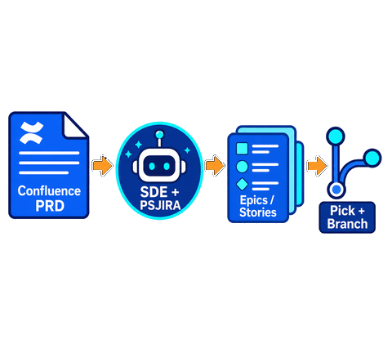
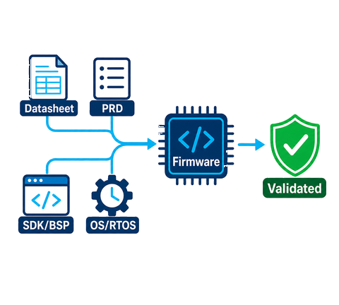
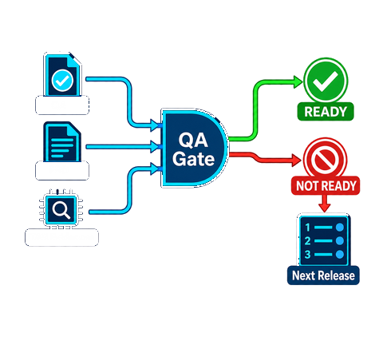
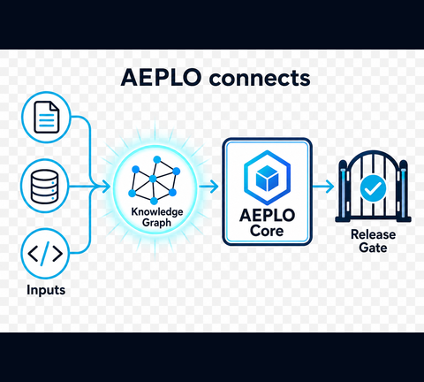
COMBINED FLOW
From Fragmentation to Release Readiness
1
2
3
4
5
Problem
Architecture
PRD -> Stories
PG3 Firmware
QA Closed Loop
Fragmented PRD, Jira, Confluence, GitHub, QA and hardware evidence slow PG1-to-PG5 decisions.
AEPLO connects inputs into a knowledge graph, orchestration core, automation and release-gate outcomes.
Confluence PRD guided by SDE Elements and PSJIRA creates epics/stories for users to pick and branch.
Datasheet + PRD + SDK/BSP + OS/RTOS context generate and validate firmware/code.
QA inputs, PRD and JTAG evidence produce READY / NOT_READY; gaps become next-release priorities.
Output: users pick traceable work, create feature branches, validate PG3 firmware with JTAG evidence, and loop through QA until READY.
HONEYWELL
2 / 5
Notes:
embedded PDLC data is
fragmented across Confluence, Jira, GitHub, QA and hardware evidence, and
AEPLO brings it into one orchestration layer. Then the Confluence PRD,
guided by SDE Elements and PSJIRA, creates epics and stories.
Next, the user picks a story and creates a feature branch with PRD and QA context.
Next , at PG3, AEPLO generates firmware from the datasheet and PRD,
injecting SDK, BSP and OS or RTOS context, then validates it against the
datasheet and acceptance criteria. Finally, QA inputs, PRD criteria and
JTAG evidence produce READY or NOT_READY; NOT_READY becomes the priority
list for the next release loop.

Slide 3
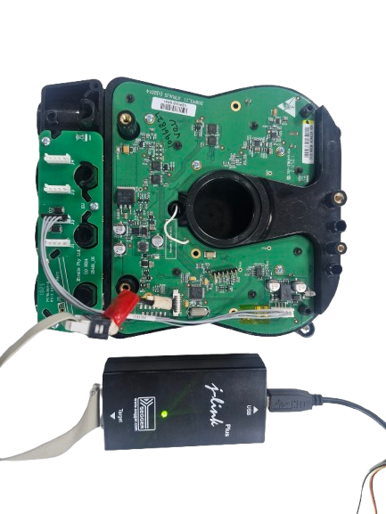
JTAG DEBUGGING AGENT
Honeywell
From Days to Hours - Autonomous Firmware Debugging
We didn’t theorize , we debugged it
Real Bugs. Real Hardware. Real Results
Case 1 – The Integration Mystery
Two components. Work separately. Combined, ends up with crash.
Agent identified root cause in 1 hour.
Estimated Story Time for investigated reduced from 3 Days to 1 Day with actual working fix , that’s 66 %-time reduction
Case 2 – The Temperature Bug
ADC fails only in cold. Needs thermal chamber to test.
Agent simulated the failure at room temperature.
Removed Chamber dependency for development
Token Optimization
Not every task needs intelligence , agent has built in smart routing that cuts cost by 95% on routine operations
Multi Agent System , Pre-loaded Instruction and lower temperature all contribute to effective token usage
Jira Ticket
JTAG Orchestrator
Sub Agents
Hardware
PR + Jira
JTAG Agentic Workflow
6 / 9

Slide 4
HONEYWELL
PG5 STQC AGENT
STQC Agent for BIS Certification
IoT security and surveillance devices need BIS certification governed by STQC guidelines for in-house designs and BTS sales.
Creates STQC Audit Evidence
STQC SUBMISSION GATE
✓
Crawls code, configuration and evidence sources to prepare auditor-ready STQC artifacts.
✓
READY
Evidence pack ready. Cleared for auditor review.
Guideline Verdict: READY / NOT_READY
◈
Checks STQC ER guidance, hard rules such as no foreign characters, and submission completeness.
✕
NOT READY
Jira Remediation Actions
Guideline gaps found. Create Jira stories.
→
Every NOT_READY result highlights the failing section and creates stories or defects to fix it.
8 / 9
Notes:
"The star of the show is the PG5 STQC agent. IoT security and surveillance
devices need BIS certification governed by STQC guidelines, for both
in-house designs and BTS sales. Earlier, developers spent months creating
evidence, validating code and preparing auditor submissions. The STQC
agent crawls the code, creates evidence, enforces hard rules like no
foreign characters, checks STQC ER guidelines, and decides whether the
submission pack is ready. If not, it highlights the section and creates
Jira tickets or stories for remediation."

Slide 5
HONEYWELL
QUANTIFIED RESULTS
Efficiency, Time Saved and Token Optimization
Realistic pilot targets for the reduced 3-minute V10 story: measurable STQC acceleration, PG3 generation, JTAG debugging, QA triage and LLM cost control.
CRITERIA
KEY METRIC FOCUS
STQC Evidence
- Submission evidence pack: 8-12 weeks -> 1-3 days - First-pack effort reduction: 90-95% - Hard-rule checks: foreign characters, STQC ER coverage, missing sections
PG3 Firmware
- Firmware first draft and validation: 12-15 months -> 8-10 months - Faster first loop: 45-60% - Context injected: datasheet, PRD, SDK, BSP, OS/RTOS
JTAG + QA Gate
- JTAG root cause: 1-2 days -> under 2 hours - QA release triage: 2-3 days -> under 4 hours - NOT_READY creates next-release Jira priorities
Agentic AI execution pattern
- Reusable agents: PRD ingestion, firmware generation, JTAG debug, QA gate, STQC - Evidence traceability: Confluence -> Jira -> GitHub -> QA -> audit pack - Human choice retained at story selection and release gate
LLM selection strategies and token optimization
- Token reduction: 35-45% using routed context and retrieval - STQC prompt caching: 80%+ reusable guideline/datasheet context on repeat runs - Compact evidence summaries reduce review and audit-prep cost
FOCUS: AEPLO loops across PRD, PG3 firmware, JTAG, QA and STQC until READY.
9 / 9
Notes:
"The realistic impact is material: STQC evidence preparation drops from
8 to 12 weeks into 1 to 3 days, PG3 firmware loops are 45 to 60 percent faster, JTAG root
cause is reduced to under two hours, and routed context plus prompt caching
cuts token use by about 35 to 45 percent. AEPLO keeps looping until QA says
READY."

